Slide 1

Tutorial
Stephen Ibanez, Noa Zilberman, Robert Halstead, Sean Choi, Gianni Antichi

Slide 2
Outline
NetFPGA Overview
P4->NetFPGA Workflow Overview
Tutorial Assignments

Slide 3

Overview

Slide 4
Section I: The NetFPGA platform

Slide 5
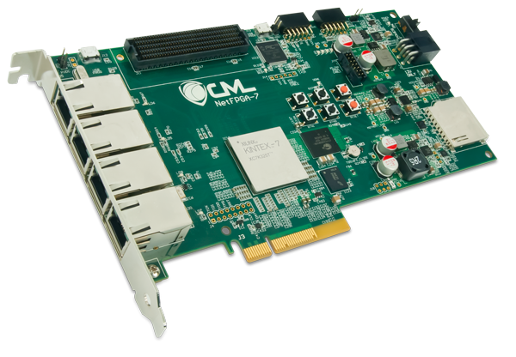
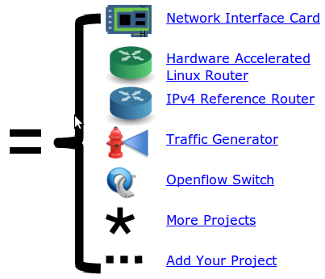
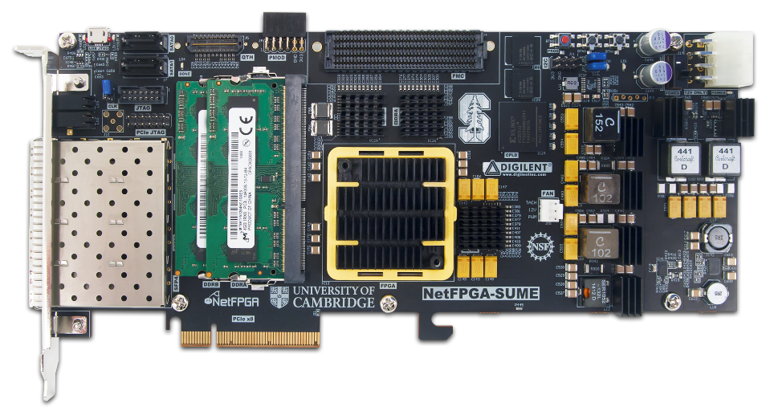
NetFPGA = Networked FPGA
A line-rate, flexible, open networking platform for teaching and research

Slide 6
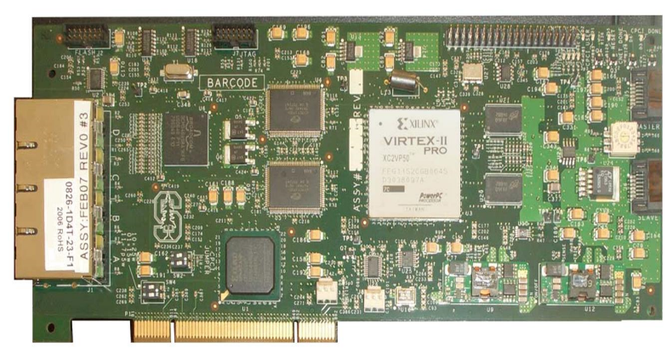
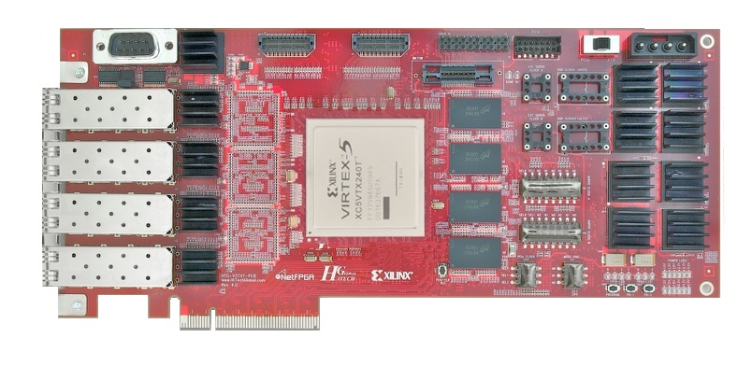

NetFPGA Family of Boards
NetFPGA-1G (2006)
NetFPGA-10G (2010)
NetFPGA-1G-CML (2014)
NetFPGA SUME (2014)

Slide 7

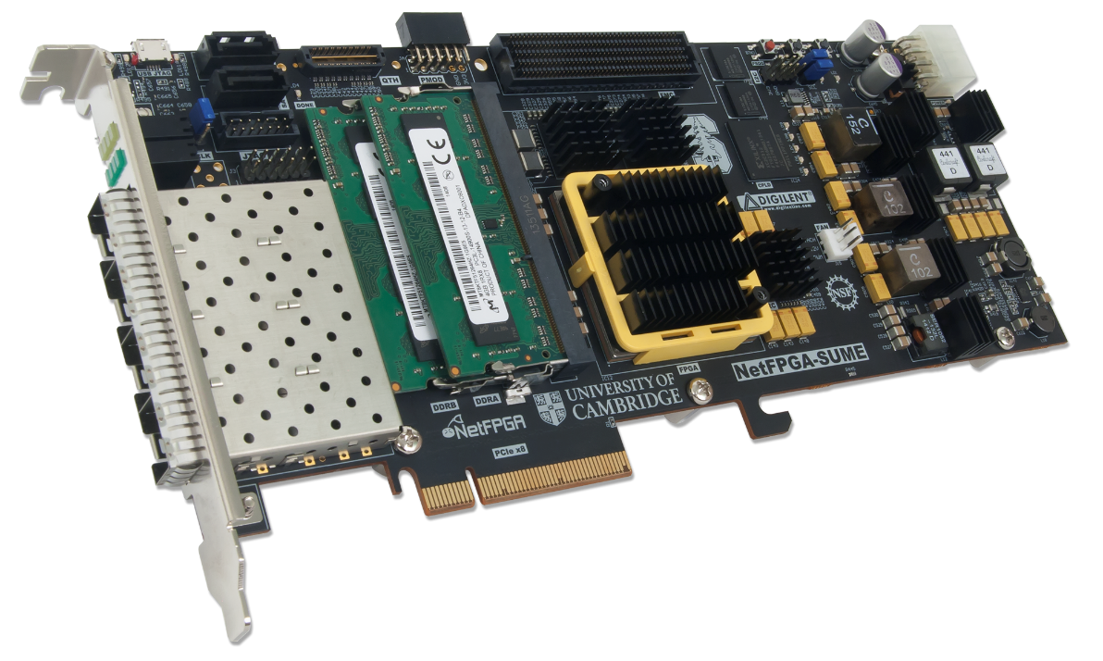
NetFPGA consists of…
Four elements:
NetFPGA board
Tools + reference designs
Contributed projects
Community

Slide 8
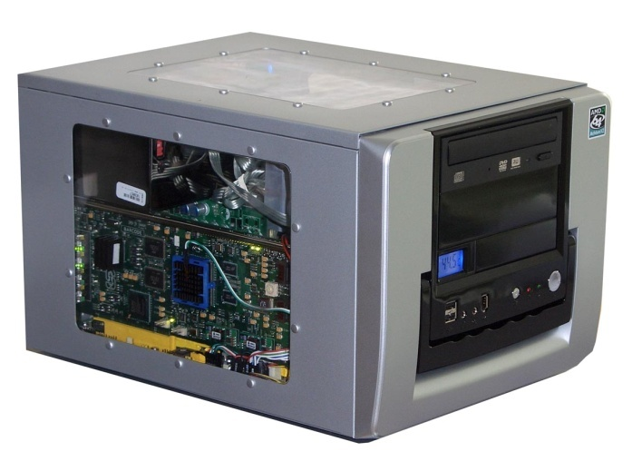

NetFPGA board
Networking Software
running on a standard PC
CPU
Memory
PCI-Express
PC with NetFPGA
A hardware accelerator
built with Field Programmable Gate Array driving 1/10/
100Gb/s network links
10GbE
FPGA
10GbE
10GbE
Memory
10GbE

Slide 9
Tools + Reference Designs
Tools:
Compile designs
Verify designs
Interact with hardware
Reference designs:
Router (HW)
Switch (HW)
Network Interface Card (HW)
Router Kit (SW)
SCONE (SW)

Slide 10
Community
Wiki
Documentation
User’s Guide “so you just got your first NetFPGA”
Developer’s Guide “so you want to build a …”
Encourage users to contribute
Forums
Support by users for users
Active community - 10s-100s of posts/week

Slide 11
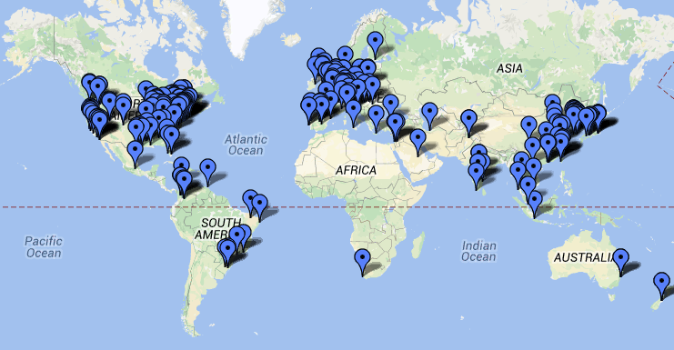
International Community
Over 1,200 users, using over 3500 cards at
200 universities in over 47 countries

Slide 12
NetFPGA’s Defining Characteristics
Line-Rate
Processes back-to-back packets
Without dropping packets
At full rate
Operating on packet headers
For switching, routing, and firewall rules
And packet payloads
For content processing and intrusion prevention
Open-source Hardware
Similar to open-source software
Full source code available
BSD-Style License for SUME, LGPL 2.1 for 10G
But harder, because
Hardware modules must meet timing
Verilog & VHDL Components have more complex interfaces
Hardware designers need high confidence in specification of modules

Slide 13
Test-Driven Design
Regression tests
Have repeatable results
Define the supported features
Provide clear expectation on functionality
Example: Internet Router
Drops packets with bad IP checksum
Performs Longest Prefix Matching on destination address
Forwards IPv4 packets of length 64-1500 bytes
Generates ICMP message for packets with TTL <= 1
Defines how to handle packets with IP options or non IPv4
… and dozens more … Every feature is defined by a regression test

Slide 14
Who, How, Why
Who uses the NetFPGA?
Researchers
Teachers
Students
How do they use the NetFPGA?
To run the Router Kit
To build modular reference designs
IPv4 router
4-port NIC
Ethernet switch, …
Why do they use the NetFPGA?
To measure performance of Internet systems
To prototype new networking systems

Slide 15
Section II: Hardware Overview

Slide 16
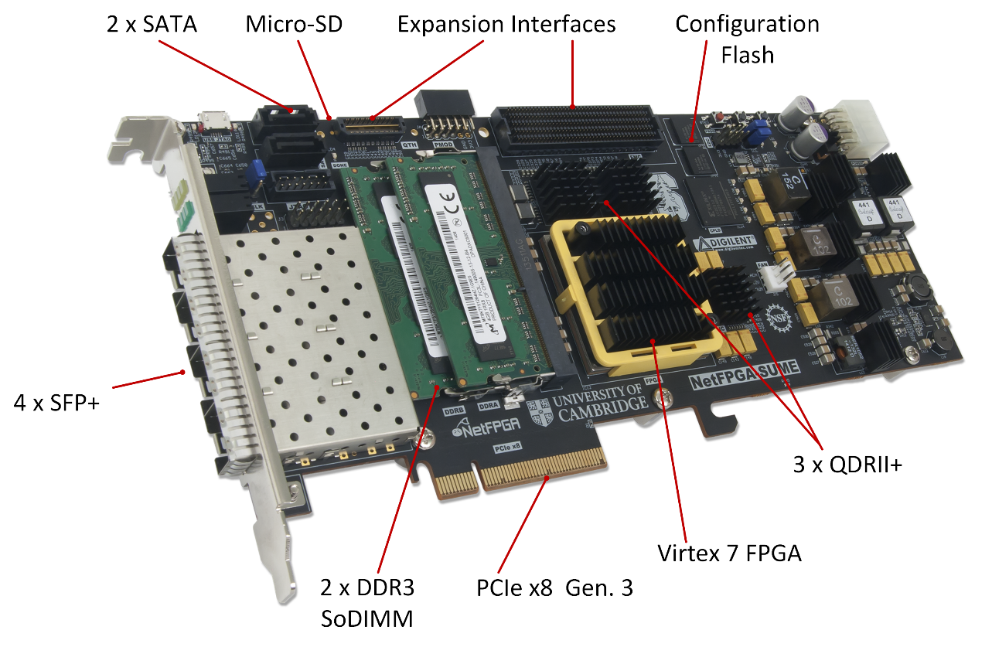
NetFPGA-SUME

Slide 17
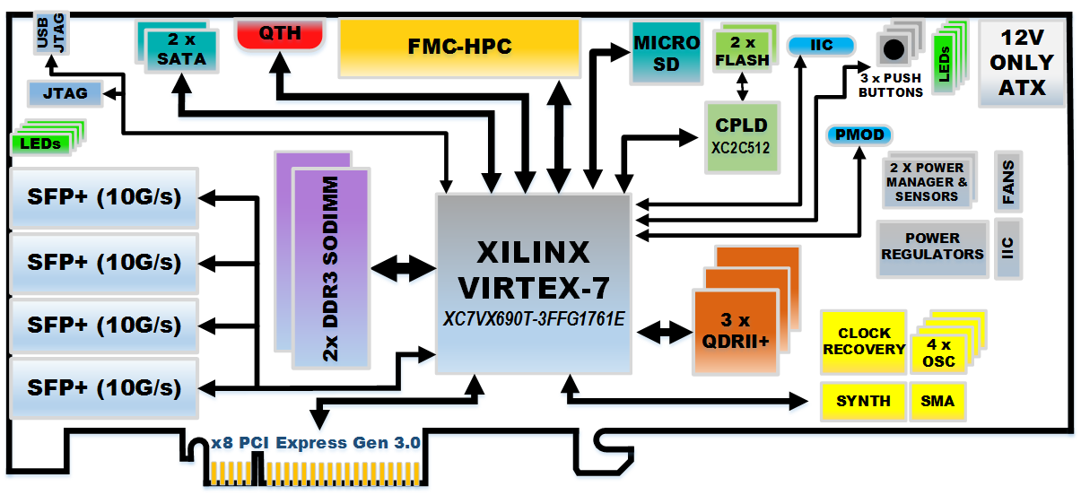
NetFPGA-SUME
High Level Block Diagram

Slide 18

Xilinx Virtex 7 690T
Optimized for high-performance applications
690K Logic Cells
52Mb RAM
3 PCIe Gen. 3 Hard cores

Slide 19
Memory Interfaces
DRAM: 2 x DDR3 SoDIMM 1866MT/s, 4GB
SRAM: 3 x 9MB QDRII+, 500MHz

Slide 20
Host Interface
PCIe Gen. 3
x8 (only)
Hardcore IP

Slide 21
Front Panel Ports
4 SFP+ Cages
Directly connected to the FPGA
Supports 10GBase-R transceivers (default)
Also Supports 1000Base-X transceivers and direct attach cables

Slide 22
Expansion Interfaces
FMC HPC connector
VITA-57 Standard
Supports Fabric Mezzanine Cards (FMC)
10 x 12.5Gbps serial links
QTH-DP
8 x 12.5Gbps serial links

Slide 23
Storage
128MB FLASH
2 x SATA connectors
Micro-SD slot
Enable standalone operation

Slide 24

Beyond Hardware
NetFPGA Board
Xilinx Vivado based IDE
Reference designs using AXI4
Software (embedded and PC)
Public Repository
Public Wiki
GitHub, User Community
MicroBlaze SW
PC SW
Xilinx Vivado
Reference Designs
AXI4 IPs

Slide 25
Integrated Circuit Technology
And Field Programmable Gate Arrays (FPGAs)

Slide 26
Integrated Circuit Technology
Full-custom Design
Complementary Metal Oxide Semiconductor (CMOS)
Semi-custom ASIC Design
Gate array
Standard cell
Programmable Logic Device
Programmable Array Logic
Field Programmable Gate Arrays
Processors

Slide 27
Xilinx Virtex-7
FF
FF/L
Logic Resources
Memory resources
Macro blocks
Clocking resources
Routing resources
I/O resource
….
A program is limited by the available resources
A program keeps running:
Until reprogrammed
Until a power cycle
LUT/RAM/SRL
LUT/RAM/SRL
LUT/RAM/SRL
LUT/RAM/SRL
0 1
Diagram From: Xilinx, Inc.

Slide 28
Section III: Life of a Packet

Slide 29
Reference Switch Pipeline
Five stages
Input port
Input arbitration
Forwarding decision and packet modification
Output queuing
Output port
Packet-based module interface
Pluggable design
10GE
RxQ
10GE
RxQ
10GE
RxQ
10GE
RxQ
DMA
Input Arbiter
Output Port Lookup
Output Queues
10GE
Tx
10GE
Tx
10GE
Tx
10GE
Tx
DMA

Slide 30
Full System Components
Software
Application
Driver
nf0
nf1
nf2
nf3
ioctl
PCIe Bus
DMA
Registers
CPU
RxQ
CPU
TxQ
AXI Lite
NetFPGA
user data path
MAC
TxQ
MAC
RxQ
MAC
TxQ
MAC
RxQ
MAC
TxQ
MAC
RxQ
10GE
Tx
10GE
Rx
Ports

Slide 31

Life of a Packet through the Hardware
00:0a:..:0Y
00:0a:..:0X
ETH packet
Port 1
Port 2

Slide 32
10GE Rx Queue
10GE Rx Queue
Eth Hdr:
Dst MAC,
Src MAC
Data

Slide 33
10GE Rx Queue
10GE Rx Queue
Length, Src port, Dst port, User defined
Eth Hdr:
Dst MAC, Src MAC
0
Payload
TUSER
TDATA

Slide 34
Input Arbiter
Rx
4
Input Arbiter
Pkt
…
Rx
1
Pkt
Rx
0
Pkt

Slide 35
Output Port Lookup
Output Port Lookup
Length, Src port, Dst port, User defined
Packet Header
0
Payload

Slide 36
Output Queues
Output Queues
OQ0
OQ2
Pkt
OQ4

Slide 37
10GE Port Tx
10GE Port Tx
Length, Src port, Dst port, User defined
Eth Hdr: Dst MAC , Src MAC
0
Payload

Slide 38
MAC Tx Queue
MAC Tx Queue
Length, Src port, Dst port, User defined
Eth Hdr: Dst MAC , Src MAC
0
Payload

Slide 39
NetFPGA-Host Interaction
Linux driver interfaces with hardware
Packet interface via standard Linux network stack
Register reads/writes via ioctl system call with wrapper functions:
rwaxi(int address, unsigned *data);
eg:
rwaxi(0x7d4000000, &val);
Notes:
Named registers are flakey

Slide 40



NetFPGA-Host Interaction
NetFPGA to host packet transfer
1. Packet arrives – forwarding table sends to DMA queue
2. Interrupt notifies driver of packet arrival
3. Driver sets up and initiates DMA transfer
PCIe Bus

Slide 41
NetFPGA-Host Interaction
NetFPGA to host packet transfer (cont.)
5. Interrupt signals completion of DMA
4. NetFPGA transfers packet via DMA
PCIe Bus
6. Driver passes packet to network stack

Slide 42
NetFPGA-Host Interaction
Host to NetFPGA packet transfers
2. Driver sets up and initiates DMA transfer
3. Interrupt signals completion of DMA
PCIe Bus
1. Software sends packet via network sockets Packet delivered to driver

Slide 43
NetFPGA-Host Interaction
Register access
2. Driver performs PCIe memory read/write
PCIe Bus
1. Software makes ioctl call on network socket ioctl passed to driver

Slide 44
P4->NetFPGA Workflow Overview

Slide 45
General Process for Programming a P4 Target
P4->NetFPGA tools
SimpleSumeSwitch
Architecture
NetFPGA SUME
Notes:
So here is the general process for programming a P4 target.
The manufacturer of the target provides the P4 programmer with 3 things
The target itself
A compiler that takes in the P4 program and generates the data-plane runtime implementation for the target, as well as an API to allow the control plane to interact with the tables and other stateful elements in the data-plane
The manufacturer also provides a P4 architecture model for their target that the user then instantiates with their P4 program.
Target = NetFPGA
P4 compiler = P4->NetFPGA Workflow

Slide 46
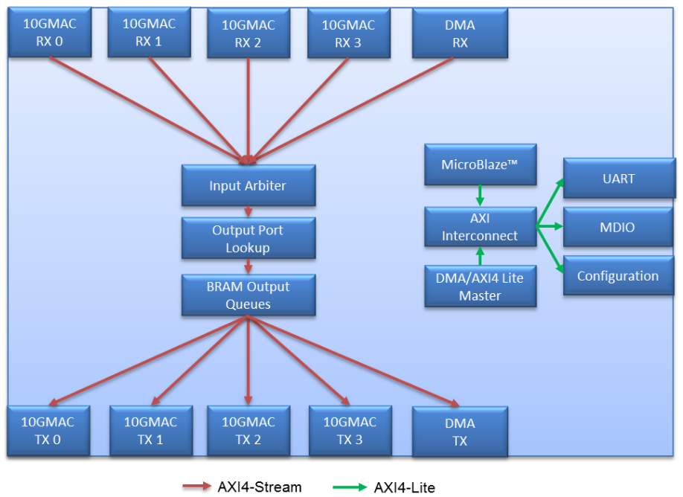
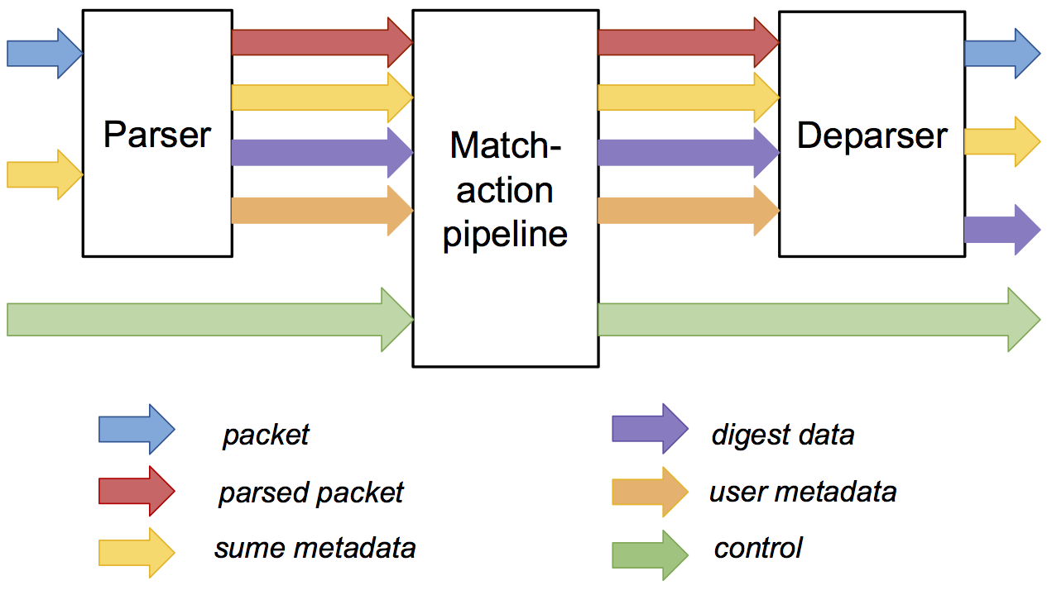
P4->NetFPGA Compilation Overview
P4 Program
NetFPGA Reference Switch
Xilinx P4₁₆ Compiler
Xilinx SDNet Tools
SSS
SimpleSumeSwitch Architecture

Slide 47
SimpleSumeSwitch Architecture Model for SUME Target
tdata
tdata
tuser
tuser
AXI
Lite
AXI
Lite
P4 used to describe parser, match-action pipeline, and deparser
Notes:
Here is the particular P4 architecture model that we are currently using for the SUME target, which we are calling the SimpleSumeSwitch architecture because it is pretty much the most basic thing that we could do.
As you can see, it consists of …
The P4 programmer is responsible for filling in the implementation of the parser, match-action pipeline, and deparser with their P4 program
Name buses – axi_stream, axi_lite

Slide 48
Metadata in SimpleSumeSwitch Architecture
/* standard sume switch metadata */
struct sume_metadata_t {
bit<16> dma_q_size;
bit<16> nf3_q_size;
bit<16> nf2_q_size;
bit<16> nf1_q_size;
bit<16> nf0_q_size;
bit<8> send_dig_to_cpu; // send digest_data to CPU
bit<8> drop;
bit<8> dst_port; // one-hot encoded
bit<8> src_port; // one-hot encoded
bit<16> pkt_len; // unsigned int
}
*_q_size – size of each output queue, measured in terms of 32-byte words, when packet starts being processed by the P4 program
src_port/dst_port – one-hot encoded, easy to do multicast
user_metadata/digest_data – structs defined by the user
Notes:
Here is the current definition of the standard SUME metadata bus
This bus consists of the fields that are set or used by other parts of the switch architecture outside of the parser, match-action pipeline, and deparser
It consists of things like …

Slide 49
SimpleSumeSwitch vs. V1 Model
/* standard sume switch metadata */
struct sume_metadata_t {
bit<16> dma_q_size;
bit<16> nf3_q_size;
bit<16> nf2_q_size;
bit<16> nf1_q_size;
bit<16> nf0_q_size;
bit<8> send_dig_to_cpu;
bit<8> drop;
bit<8> dst_port;
bit<8> src_port;
bit<16> pkt_len;
}
/* standard V1 switch metadata* */
struct standard_metadata_t {
bit<32> enq_timestamp;
bit<32> deq_timedelta;
bit<19> enq_qdepth;
bit<19> deq_qdepth;
bit<9> egress_port;
bit<32> clone_spec;
bit<1> drop;
bit<9> egress_spec;
bit<9> ingress_port;
bit<32> packet_length;
bit<32> instance_type;
bit<16> recirculate_port;
bit<48> ingress_global_timestamp;
bit<32> lf_field_list;
bit<16> mcast_grp;
bit<1> resubmit_flag;
bit<16> egress_rid;
}
*reordered for alignment
Notes:
- Here is a comparison of the standard metadata fields in the SimpleSumeSwitch and the V1 model
- As you can see there is some

Slide 50
Overall P4 Program Structure
#include <core.p4>
#include <sume_switch.p4>
/******** CONSTANTS ********/
#define IPV4_TYPE 0x0800
/******** TYPES ********/
typedef bit<48> EthAddr_t;
header Ethernet_h {...}
struct Parsed_packet {...}
struct user_metadata_t {...}
struct digest_data_t {...}
/******** EXTERN FUNCTIONS ********/
extern void const_reg_rw(...);
/******** PARSERS and CONTROLS ********/
parser TopParser(...) {...}
control TopPipe(...) {...}
control TopDeparser(...) {...}
/******** FULL PACKAGE ********/
SimpleSumeSwitch(TopParser(), TopPipe(), TopDeparser()) main;

Slide 51
Externs
Implement platform specific functions
Black box to P4 program
Stateless – reinitialized for each packet
Stateful – keep state between packets
Xilinx Annotations
@Xilinx_MaxLatency() – maximum number of clock cycles an extern function needs to complete
@Xilinx_ControlWidth() – size in bits of the address space to allocate to an extern function

Slide 52
P4->NetFPGA Extern Function Library
HDL modules invoked from within P4 programs
Stateful Atoms
Stateless Externs
Add your own!
Atom | Description
R/W | Read or write state
RAW | Read, add to, or overwrite state
PRAW | Predicated version of RAW
ifElseRAW | Two RAWs, one each for when predicate is true or false
Sub | IfElseRAW with stateful subtraction capability
Atom | Description
IP Checksum | Given an IP header, compute IP checksum
LRC | Longitudinal redundancy check, simple hash function
timestamp | Generate timestamp (granularity of 5 ns)
Notes:
- Extern implementations must be able to accept data on every clock cycle, so they must be pipelined if they take more than 1 clock cycle to complete.

Slide 53
Using Atom Externs in P4 – Resetting Counter
Packet processing pseudo code:
count[NUM_ENTRIES];
if (pkt.hdr.reset == 1):
count[pkt.hdr.index] = 0
else:
count[pkt.hdr.index]++

Slide 54
Using Atom Externs in P4 – Resetting Counter
#define REG_READ 0
#define REG_WRITE 1
#define REG_ADD 2
// count register
@Xilinx_MaxLatency(1)
@Xilinx_ControlWidth(3)
extern void count(in bit<3> index,
in bit<32> newVal,
in bit<32> incVal,
in bit<8> opCode,
out bit<32> result);
bit<16> index = pkt.hdr.index;
bit<32> newVal;
bit<32> incVal;
bit<8> opCode;
if(pkt.hdr.reset == 1) {
newVal = 0;
incVal = 0; // not used
opCode = REG_WRITE;
} else {
newVal = 0; // not used
incVal = 1;
opCode = REG_ADD;
}
bit<32> result; // the new value stored in count
count_reg_raw(index, newVal, incVal, opCode, result);
State can be accessed exactly 1 time
Using RAW atom here
Instantiate atom
Set metadata for state access
Single state access!

Slide 55
P4-NetFPGA Workflow
All of your effort will go here
Write P4 program
Write python gen_testdata.py script
Compile to verilog / generate API & CLI tools
$ make
Run initial SDNet simulation
$ ./vivado_sim.bash
Install SDNet output as SUME library core
$ make install_sdnet
Run NetFPGA simulation
$ ./nf_test sim –major switch –minor default
Build bitstream
$ make
Test the hardware
Notes:
Tools to help write testdata
sss_sdnet_tuples
scapy
Tools to help debug failing simulations
Parsing simulation output into header / metadata fields

Slide 56
Directory Structure of $SUME_FOLDER
P4-NetFPGA-SIGCOMM/
|
|- contrib-projects/
| |- sume-sdnet-switch/ → the main directory for P4 dev
|
|- lib/ → contains all of the SUME IP cores
|
|- tools/ → various NetFPGA scripts for test infra.
|
|- Makefile → builds all of the SUME IP cores

Slide 57
Directory Structure of $SUME_SDNET
sume-sdnet-switch/
|
|- bin/ → scripts used to automate workflow
|
|- templates/ → templates for externs, wrapper module,
| CLI tools, new projects
|
|- projects/ → all of the P4 project directories
| |- switch_calc/

Slide 58
Directory Structure of $P4_PROJECT_DIR
$P4_PROJECT_DIR/
|
|- src/ → P4 source files and commands.txt
|
|- testdata/ → scripts to generate testdata used for
| verifying functionality of P4 program
|
|- simple_sume_switch/ → main SUME project directory,
| top level HDL files and SUME sim scripts
|
|- sw/ → populated with API files and CLI tools and any
| user software for the project
|
|- nf_sume_sdnet_ip/ → SDNet output directory

Slide 59
API & Interactive CLI Tool Generation
Both Python API and C API
Manipulate tables and stateful elements in P4 switch
Used by control-plane program
CLI tool
Useful debugging feature
Query various compile-time information
Interact directly with tables and stateful elements in real time

Slide 60
Debugging P4 Programs
SDNet HDL simulation
SDNet C++ simulation
Verbose packet processing info
Output PCAP file
Full SUME design HDL simulation

Slide 61
What can you do in 2.5 days?
Examples from the recent NetFPGA Summer Camp:
Heavy hitter detection
Event triggered network monitor
Packet Fuzzer
Tic-Tac-Toe

Slide 62
Get the Tools!
Fill out P4->NetFPGA github registration form: here
Request P4->NetFPGA tools and licenses from Xilinx: here
P4-SDNet License
Vivado license
10G MAC Core license
(For academic users) Request special price NetFPGA SUME: here
(For industry users) Purchase NetFPGA SUME from Digilent: here
Read the documentation: here

Slide 63
Today’s Development Process
Google Compute Instance:
P4 development
P4 -> HDL compilation
Simulation + debugging
Bitstream generation
Hardware Test Machines:
Testing on SUME boards
Connecting to machines:
Use “p4-netfpga-ssh-key”
Command line development OR VNC client

Slide 64
Tutorial Assignments

Slide 65
Tutorial Assignments
Assignments described at this link:
https://github.com/NetFPGA/P4-NetFPGA-public/wiki/Tutorial-Assignments
Short version:
https://tinyurl.com/P4-NetFPGA-SIGCOMM-17

Slide 66
Assignment 1: Switch as a Calculator

Slide 67
Switch as Calculator
Supported Operations:
ADD – add two operands
SUBTRACT – subtract two operands
ADD_REG – add operand to current value in register
SET_REG – overwrite the current value of the register
LOOKUP – Lookup the given key in the table
header Calc_h {
bit<32> op1;
bit<8> opCode;
bit<32> op2;
bit<32> result;
}

Slide 68
Switch as Calculator
User PC
NetFPGA SUME
Ethernet
DST: MAC1
SRC: MAC2
Type: CALC_TYPE
Calc
op1: 1
opCode: ADD
op2: 2
result: 0
Payload…

Slide 69
Switch as Calculator
User PC
NetFPGA SUME
Ethernet
DST: MAC1
SRC: MAC2
Type: CALC_TYPE
Calc
op1: 1
opCode: ADD
op2: 2
result: 0 3
X
Payload…

Slide 70
Switch as Calculator
User PC
NetFPGA SUME
Ethernet
DST: MAC2
SRC: MAC1
Type: CALC_TYPE
Calc
op1: 1
opCode: ADD
op2: 2
result: 3
Payload…

Slide 71
Switch Calc Operations
ADD
SUB
ADD_REG
op1 op2
op1 op2
op2 const[op1]
+
-
+
result
result: op1-op2
result
SET_REG
LOOKUP
op2
key | val
0 | 1
1 | 16
2 | 16²
3 | 16³
key:
op1
result:
val
const[op1]

Slide 72
Assignment 2: TCP Monitor

Slide 73
TCP Monitor
Practice writing stateful P4 programs for NetFPGA SUME
Compute TCP flow size distribution in the data-plane
Flow is determined by 5-tuple and delimited by SYN/FIN
Fine grained flow monitoring capabilities with P4
Flow Size Distribution
# Flows
Flow Size (bytes)

Slide 74
byte_cnt
distribution
0
0-16K
0
0
16-32K
0
32-48K
Ethernet
48-64K
0
IP_src
IP_dst
Proto: TCP
0
64-80K
0
80-96K
0
96-112K
sport
dport
flags: SYN
hash
0
>112K

Slide 75
byte_cnt
distribution
0
1K
0-16K
0
0
16-32K
0
32-48K
Ethernet
0
48-64K
IP_src
IP_dst
Proto: TCP
0
64-80K
0
80-96K
0
96-112K
sport
dport
flags: ACK
0
>112K
hash
len(payload) = 1K

Slide 76
byte_cnt
distribution
1K
2K
0-16K
0
1
0
16-32K
0
32-48K
Ethernet
0
48-64K
IP_src
IP_dst
Proto: TCP
0
64-80K
0
80-96K
0
96-112K
sport
dport
flags: FIN
0
>112K
hash
len(payload) = 1K

Slide 77
Assignment 3: In-band Network Telemetry (INT)

Slide 78
In-band Network Telemetry (INT)
One of the most popular applications for programmable data-planes
All about gaining more visibility into network
Basic idea:
Source requests each switch along path to insert some desired metadata into packet (using a bitmask)
Example metadata:
Switch ID
Ingress Port
Egress Port
Timestamp
Queue Occupancy

Slide 79
In-band Network Telemetry (INT)
Bitmask format (5 bits):
<SWITCH_ID><INGRESS_PORT><Q_SIZE><TSTAMP><EGRESS_PORT>
Payload
INT
bm: 11001
Ethernet
Egress port
timestamp
Queue size
Ingress port
SwitchID

Slide 80
In-band Network Telemetry (INT)
Bitmask format (5 bits):
<SWITCH_ID><INGRESS_PORT><Q_SIZE><TSTAMP><EGRESS_PORT>
Payload
Egress port
bos: 1
Ingress port
bos: 0
SwitchID
bos: 0
INT
bm: 11001
Ethernet
Egress port
timestamp
Queue size
Ingress port
SwitchID

Slide 81
Additional Details
Notes:
Now I’ll briefly describe the process of compiling P4 programs using the Xilinx P4-SDNet toolchain
But before I do, I want to clarify that P4-SDNet is an official Xilinx product, so I haven’t had much to do with it’s development other than helping to debug a few features here and there
I was just fortunate enough to get the opportunity to put it to use for NetFPGA

Slide 82
API
Auto generated Python API
Exact match table API functions:
table_cam_add_entry()
table_cam_delete_entry()
table_cam_get_size()
table_cam_read_entry()
Ternary match table API functions:
table_tcam_add_entry()
table_tcam_clean()
table_tcam_erase_entry()
table_tcam_verify_entry()
LPM table API functions:
table_lpm_load_dataset()
table_lpm_set_active_lookup_bank()
table_lpm_verify_dataset()
Register API functions:
reg_read()
reg_write()
C API also available

Slide 83
Implementing Extern Functions
Implement verilog extern module in $SUME_SDNET/templates/externs/
Add entry to $SUME_SDNET/bin/extern_data.py
No Need to modify any existing code
If the extern has a control interface a cpu_regs module will be generated automatically to easily expose control_registers using the AXI Lite interface

Slide 84
Debugging SDNet Simulation
HDLSimulation
Xsim or Questa sim
Error:
expected < tuple_out_sume_metadata > = < 00000000000000000000000100040041 >
actual < tuple_out_sume_metadata > = < 00000000000000000000000100040040 >
$ $P4_PROJECT_DIR/testdata/sss_sdnet_tuples.py --parse 00000000000000000000000100040041 sume
Parsed Tuple:
-----------------------
dma_q_size = 0
nf3_q_size = 0
nf2_q_size = 0
nf1_q_size = 0
nf0_q_size = 0
send_dig_to_cpu = 0
drop = 1
dst_port = 00000000
src_port = 00000100
pkt_len = 65

Slide 85
Debugging SDNet Simulation
C++ model
Prints debug info
Hit or miss in tables
Header/Metadata field modification along the way
Generates Packet_expect.pcap to compare to dst.pcap
-skipEval option
Compare C++ model output to HDL simulation – make sure SDNet compiler is working properly

Slide 86
Debugging SUME Simulation
What to do if SDNet simulation passes but SUME simulation fails?
Make sure you’ve:
$ cd $P4_PROJECT_DIR && make config_writes
$ cd $NF_DESIGN_DIR/test/sim_major_minor && make
$ cd $P4_PROJECT_DIR && make install_sdnet
Run SUME simulation longer?
Make sure all configuration writes have completed before applying the test packets
Make sure SDNet module has finished reset before applying configuration writes
Check nf_*_expected.axi and nf_*_logged.axi
Add signals to simulation waveform
Perhaps issue with wrapper module?

Slide 87
SDNet Module HDL Wrapper
Located in: $SUME_SDNET/templates/sss_wrapper/
Tasks:
Generate tuple_in_VALID signal for s_axis_tuser
Reverse reset polarity
Reverses endianness of digest_data and inserts into last 80 bits of m_axis_tuser

Slide 88
Acknowledgments (I)
NetFPGA Team at University of Cambridge (Past and Present):
Andrew Moore, David Miller, Muhammad Shahbaz, Martin Zadnik, Matthew Grosvenor, Yury Audzevich, Neelakandan Manihatty-Bojan, Georgina Kalogeridou, Jong Hun Han, Noa Zilberman, Gianni Antichi, Charalampos Rotsos, Hwanju Kim, Marco Forconesi, Jinyun Zhang, Bjoern Zeeb, Robert Watson, Salvator Galea, Marcin Wojcik, Diana Andreea Popescu, Murali Ramanujam
NetFPGA Team at Stanford University (Past and Present):
Nick McKeown, Glen Gibb, Jad Naous, David Erickson, G. Adam Covington, John W. Lockwood, Jianying Luo, Brandon Heller, Paul Hartke, Neda Beheshti, Sara Bolouki, James Zeng, Jonathan Ellithorpe, Sachidanandan Sambandan, Eric Lo, Stephen Gabriel Ibanez
All Community members (including but not limited to):
Paul Rodman, Kumar Sanghvi, Wojciech A. Koszek, Yahsar Ganjali, Martin Labrecque, Jeff Shafer, Eric Keller, Tatsuya Yabe, Bilal Anwer, Yashar Ganjali, Martin Labrecque, Lisa Donatini, Sergio Lopez-Buedo , Andreas Fiessler, Robert Soule, Pietro Bressana, Yuta Tokusashi
Steve Wang, Erik Cengar, Michael Alexander, Sam Bobrowicz, Garrett Aufdemberg,
Patrick Kane, Tom Weldon
Patrick Lysaght, Kees Vissers, Michaela Blott, Shep Siegel, Cathal McCabe

Slide 89

















Acknowledgements (II)

